Slide 1

ARTIFICIAL INTELLIGENCE (AI)
Object Recognition

Slide 2
TABLE OF CONTENTS
01.
02.
03.
Object recognition overview
What is “yolo”?
samaratin
04.
05.
06.
Design
demo
Summary

Slide 3
01.
Object recognition

Slide 4
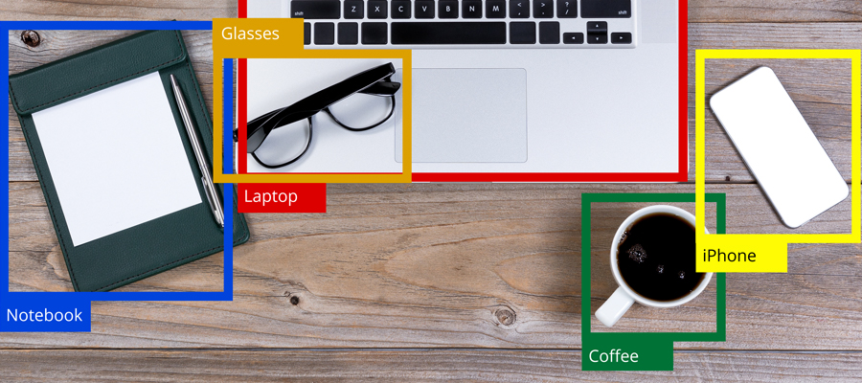
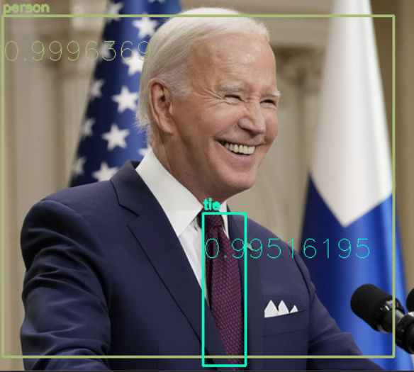

Slide 5
02.
What is “yolo”?

Slide 6
YOLO: YOu only look once
YOLO is an abbreviation for the term 'You Only Look Once'. This is an algorithm that detects and recognizes various objects in a picture (in real-time). Object detection in YOLO is done as a regression problem and provides the class probabilities of the detected images.

Slide 7
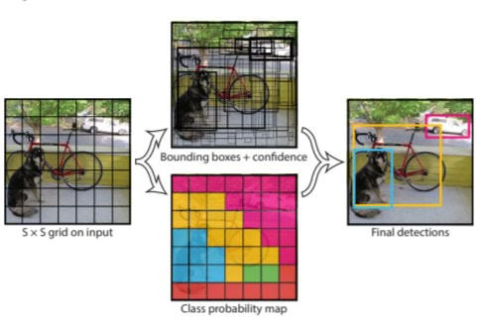

Slide 8
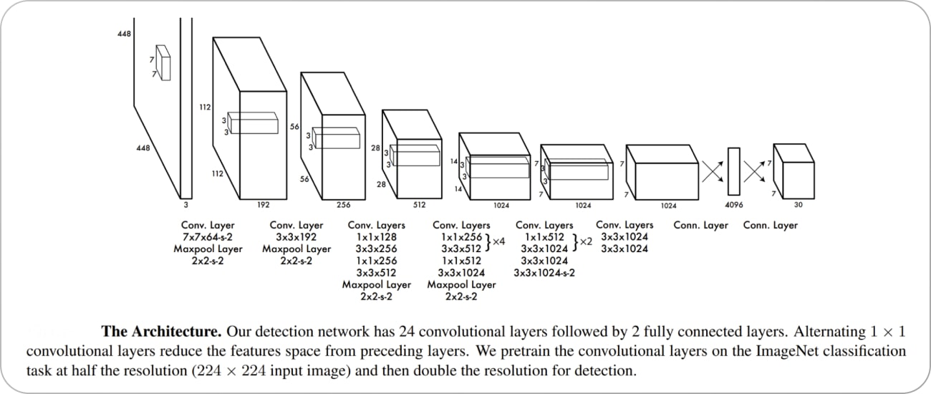
Yolo’s Architecture

Slide 9
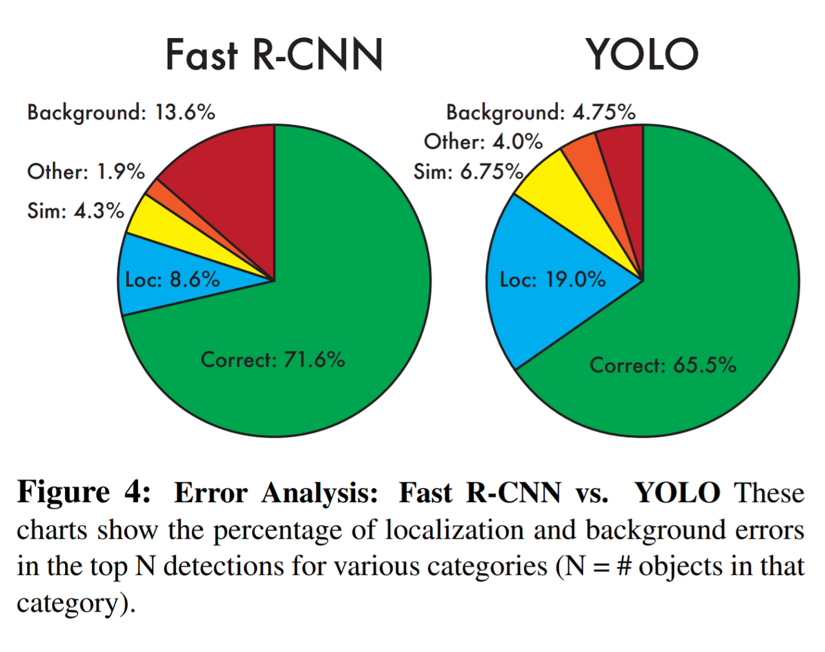
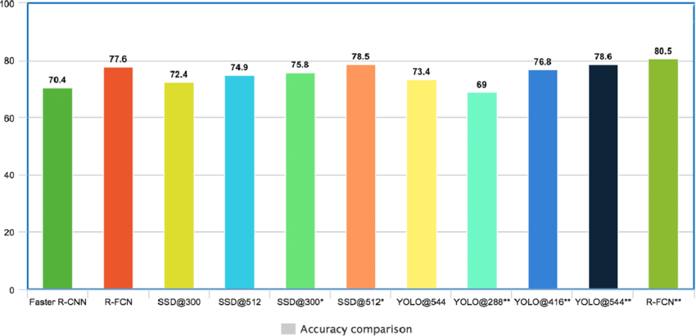

Slide 10
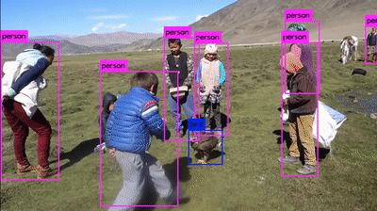
FAst yolo: Real-time detection

Slide 11
03.
samaratin

Slide 13
04.
design

Slide 14
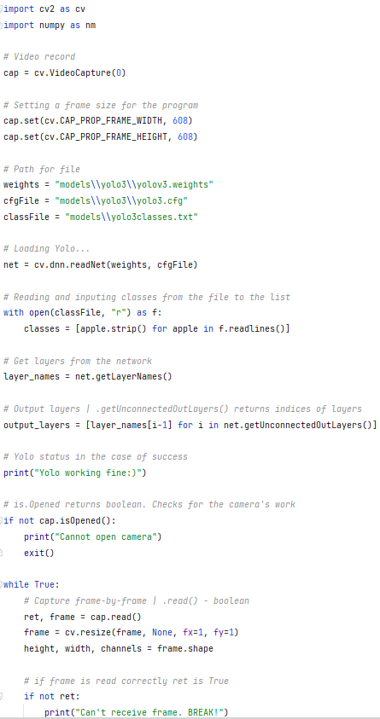
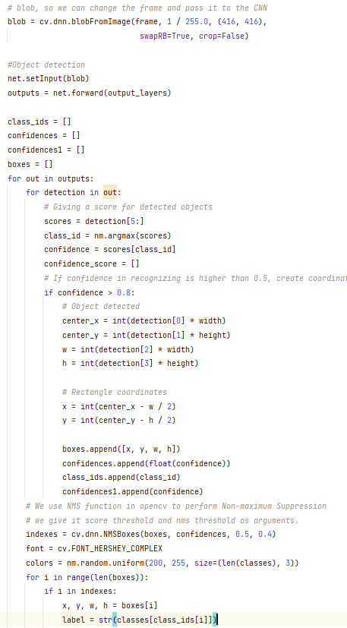
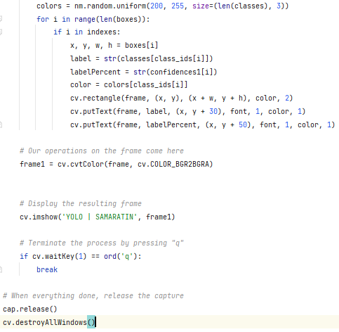

Slide 15
05.
demo

Slide 16
06.
summary

Slide 17
summary
Object detection is a computer vision task that involves identifying and localizing multiple objects within an image or video. It is a crucial component of many applications, including autonomous vehicles, surveillance systems, and augmented reality.

Slide 18
—Claude Shannon
“I visualize a time when we will be to robots what dogs are to humans, and I’m rooting for the machines.”

Slide 19
Thank you!

